Slide 1




M4EFaD - multimodal longitudinal analysis
Portlock, T., Shama, T., Kakon, S.H., Hartjen, B., Pook, C, Wilson, B.C., Ho, D., Shennon, I., Engelstad, A.M., Di Lorenzo, R., Greaves, G., Kelsey, C., Gluckman, P.D, Haque, R., Forrester, T., Nelson, C.A., O’Sullivan, J.M., on behalf of the M4EFaD consortium.

Slide 2

BACKGROUND
2023 - Foundational paper
findings:
Characterisation of the developmental damage inflicted by MAM
A potential mechanism by which the gut microbiome mediates neurocognitive development

Slide 3
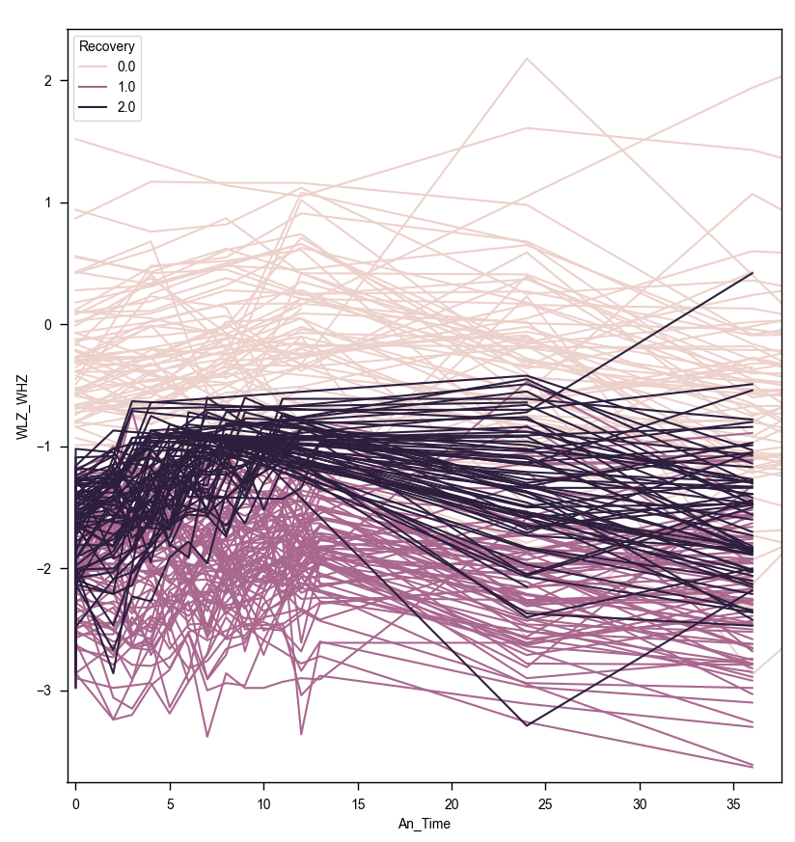
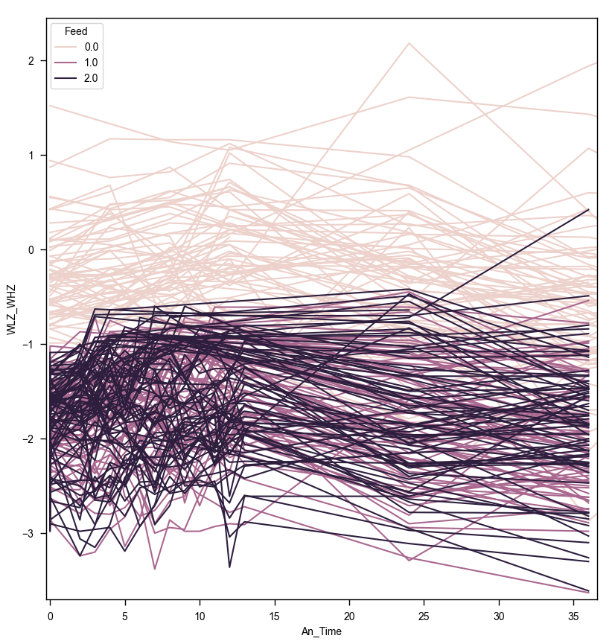

Part1: Recovery
2024 - Anthropometric recovery
 | Feed A | Feed B
Did not recover | 28 | 22
Recovered | 16 | 10
Supplement Type did not affect recovery
Chi-squared
p = 0.83
a
b
0=well nourished
1=No recovery
2=Recovered
0=well nourished
1=Supplement 1
2=Supplement 2
Less than half recovered
Weeks from baseline (1 yr)

Slide 4
Why did some MAMs children recover and not others?

Slide 5
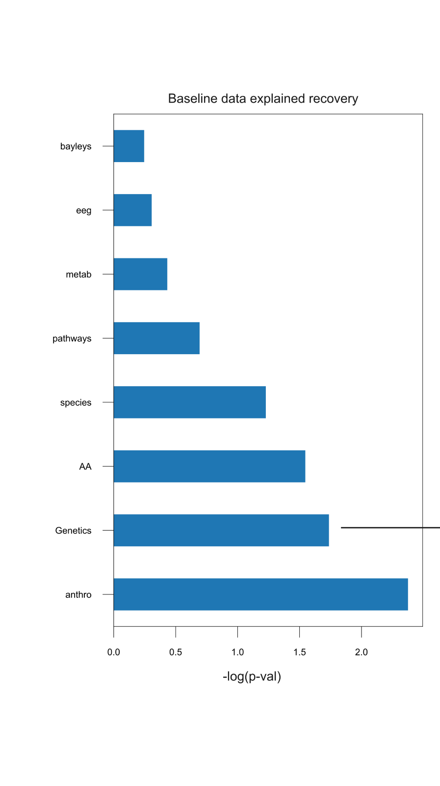
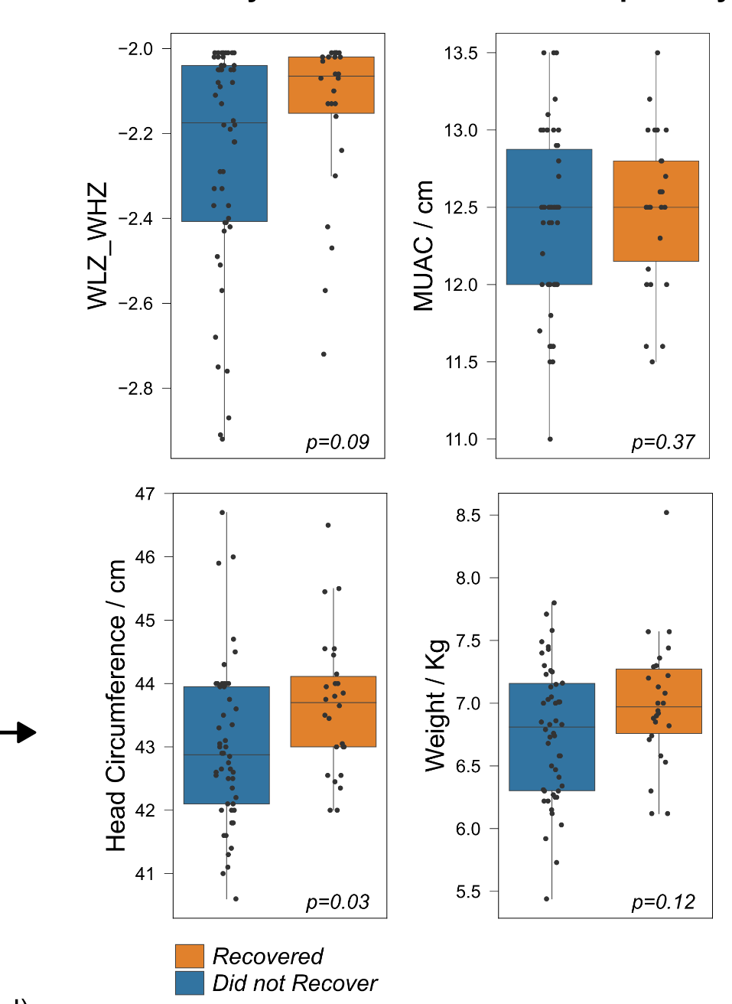
What data best explains recovery?
Recovery:baseline anthrop.

Slide 6
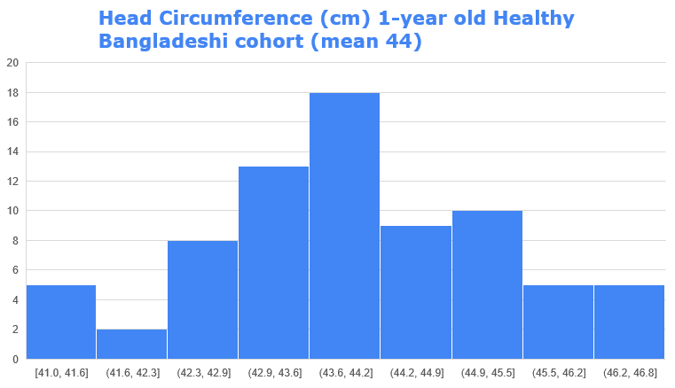

Slide 7
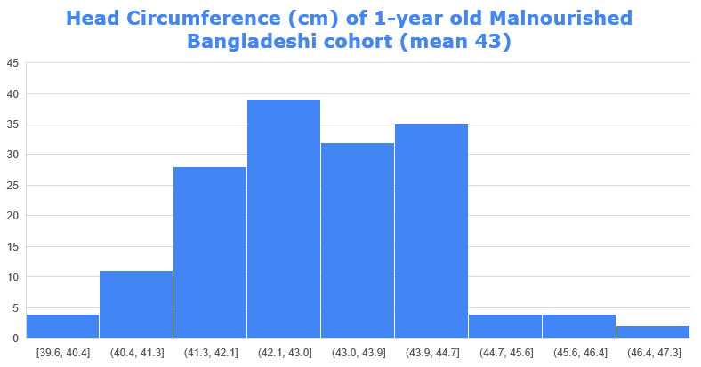

Slide 8

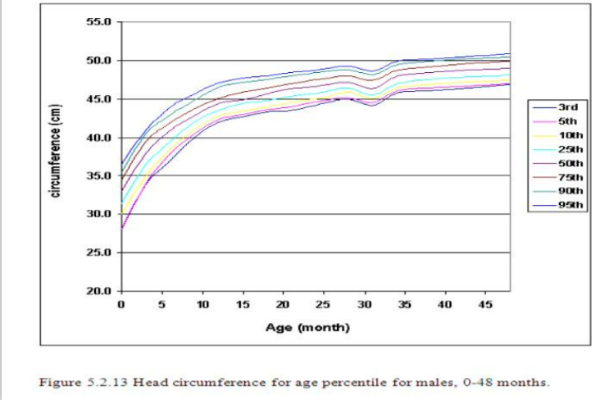
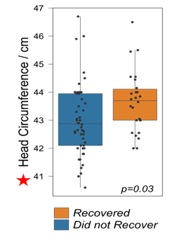
Were the children with smaller heads
impacted by malnutrition earlier in life?
Is this the time when the Malnutrition impacted,
or is it due to growth restriction in the womb?

Slide 9
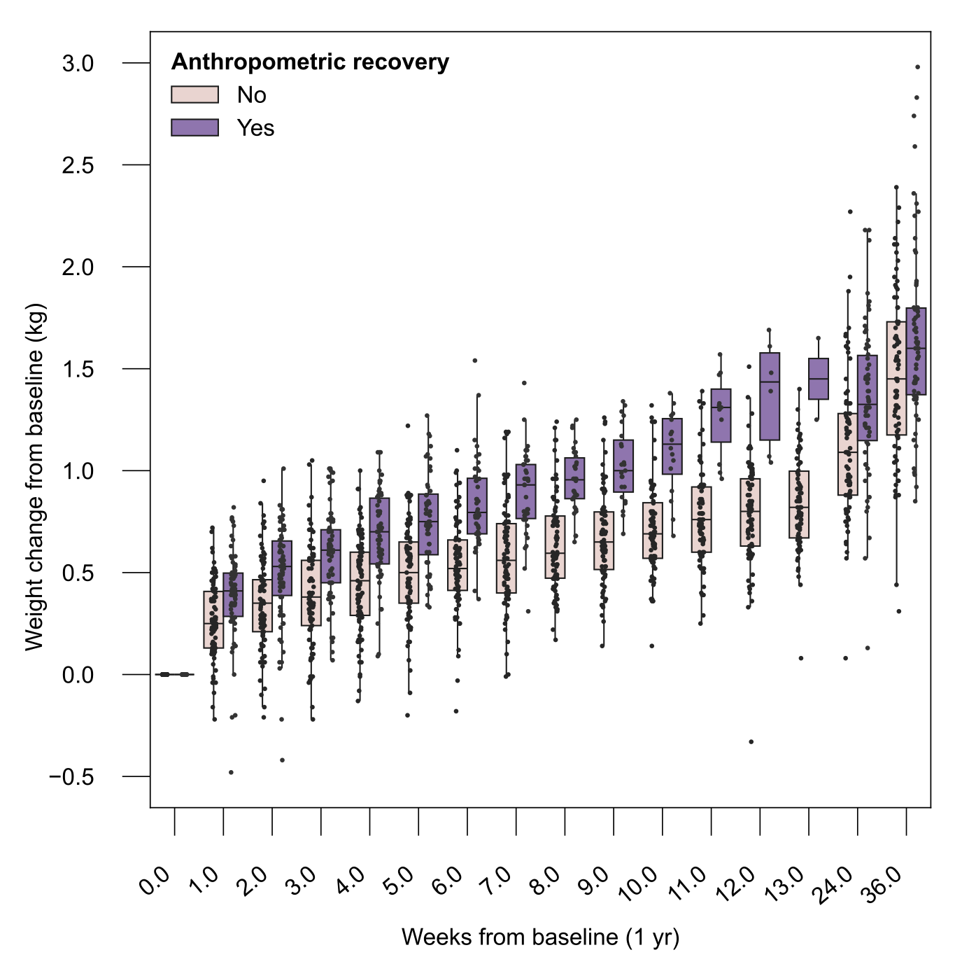
Infants who were more likely to recover had: 1) rapid weight gain 2) higher starting weights

Slide 10
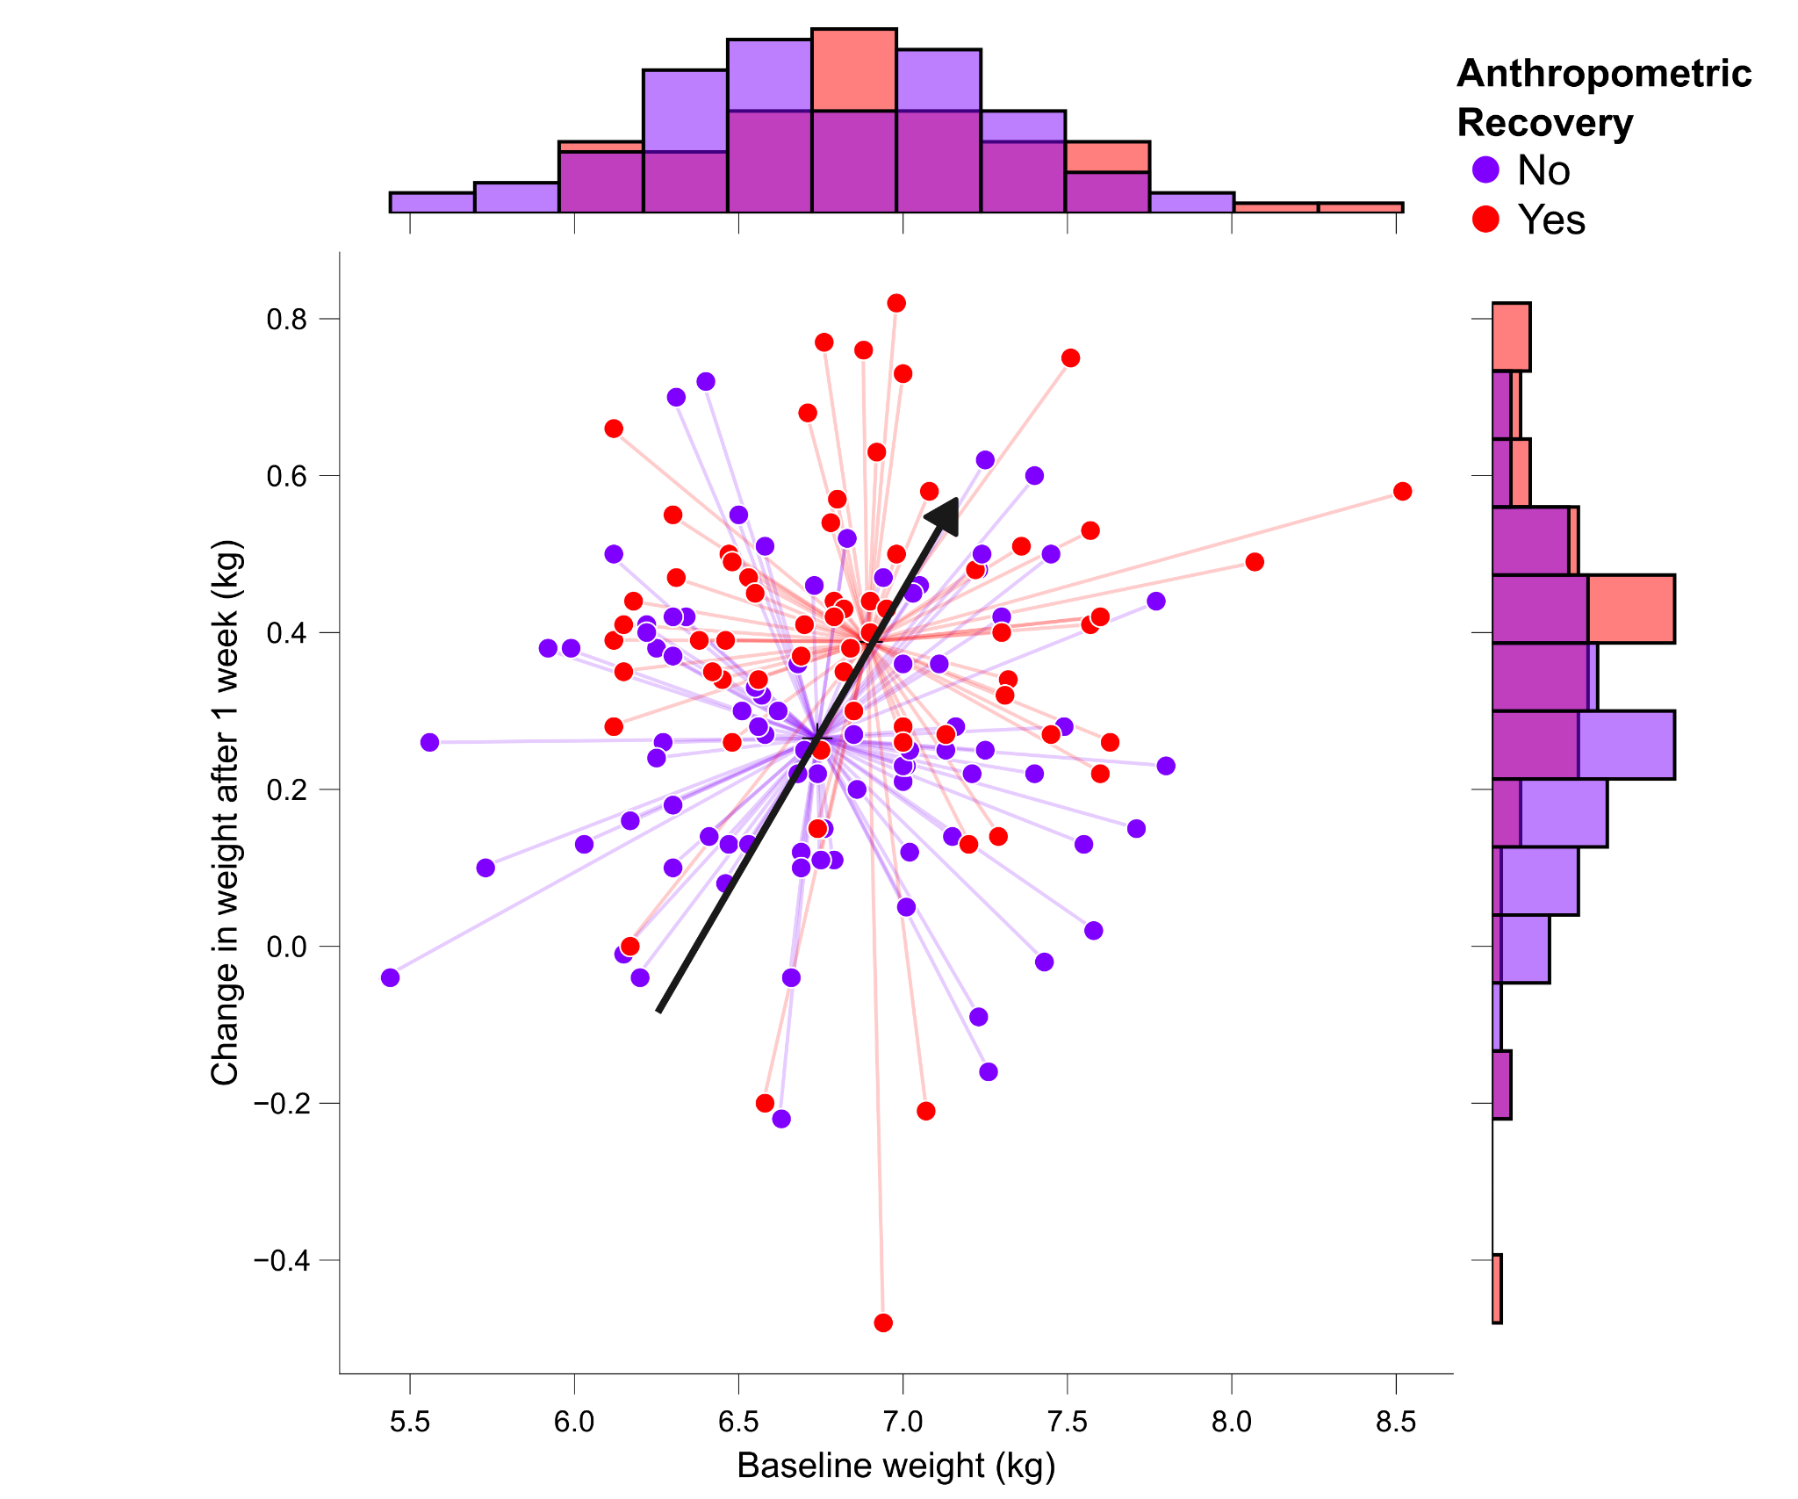
Infants who were greater weight change after 1 week had: 1) higher starting weight 2) greater chance of recovery
Hypothesis:
More severely malnourished infants had difficulties gaining weight
nutrient absorption / energy intake issues?

Slide 11
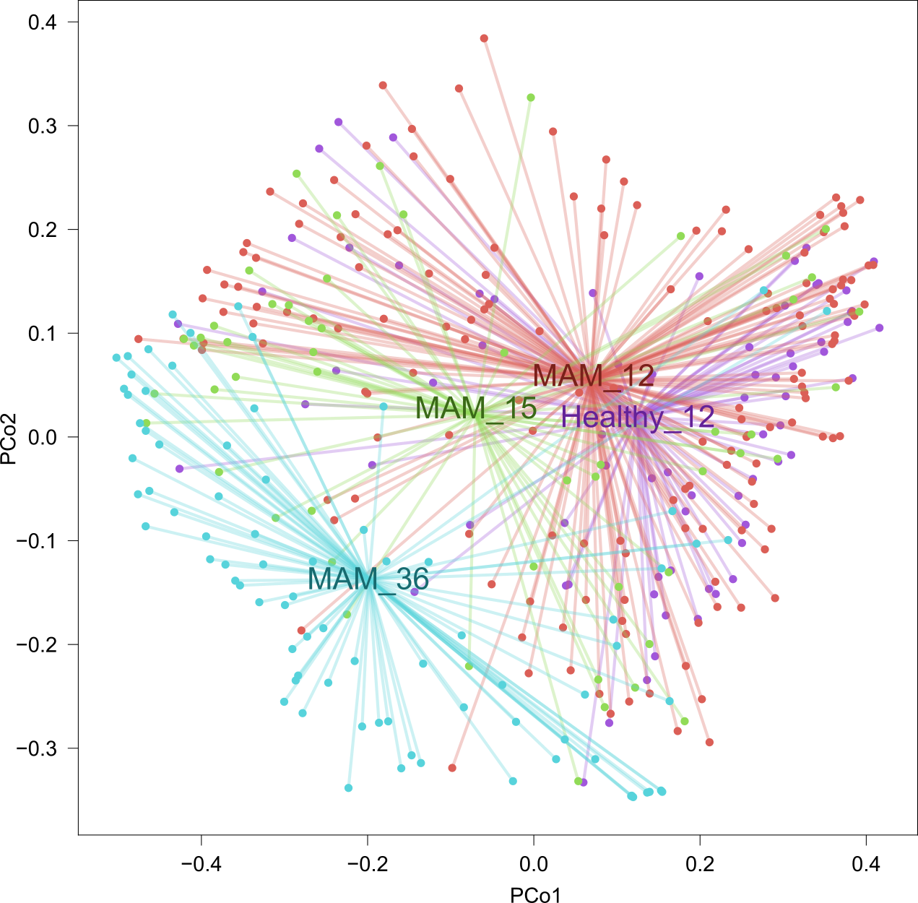
Species composition at baseline differed
Did the microbiome predict recovery?

Slide 12
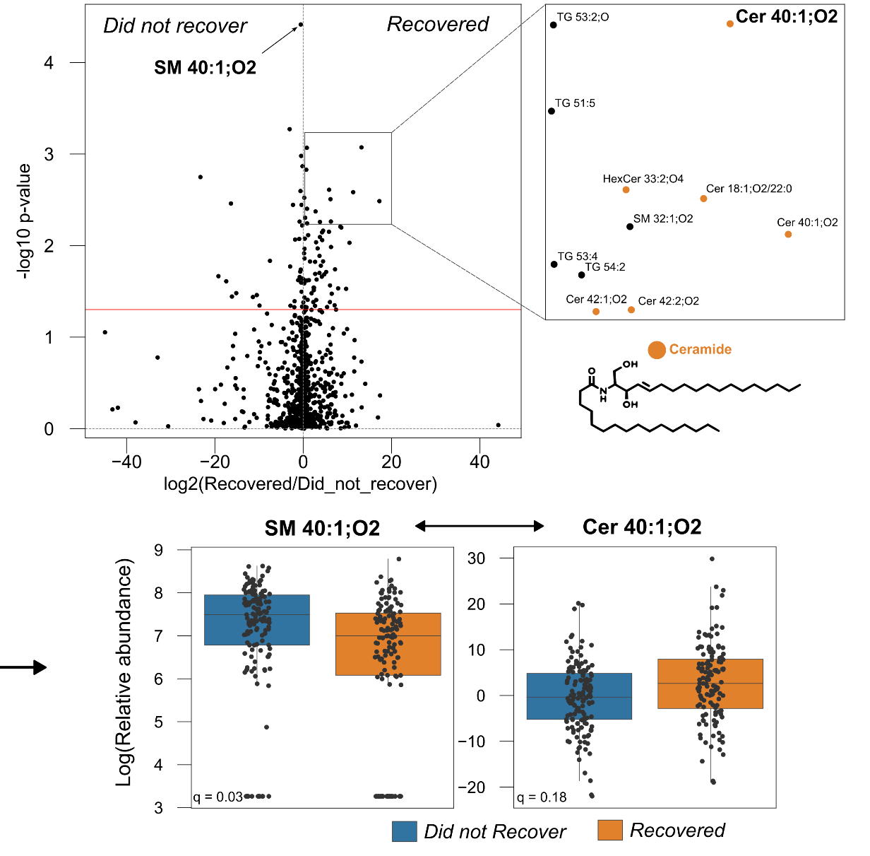
What data best explains recovery?
Recovery:baseline plasma lipids

Slide 13
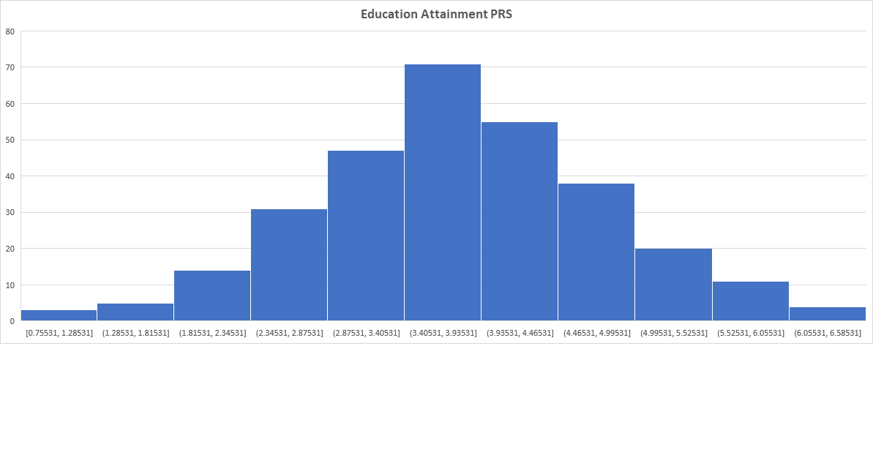
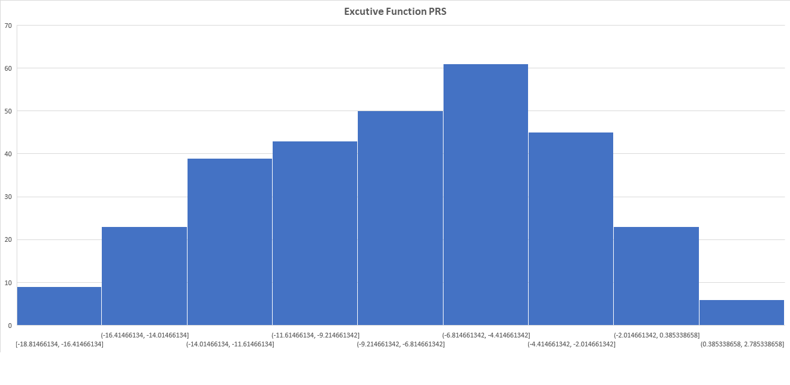

Polygenic risk scores have been calculated for the MAMs children
EF PRS is based on GUSTO EF study by D. Ho.

Slide 14
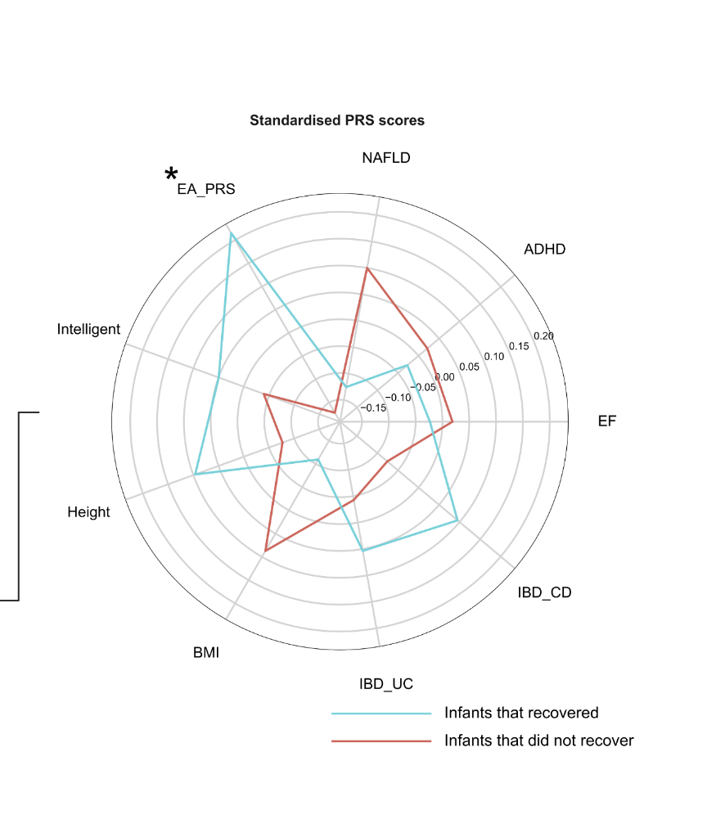
Child’s genetics also makes a significant contribution to recovery

Slide 15
What about cognitive recovery?
Will uncover when EF measures are released

Slide 16
Part2: Exploratory multi-omic analysis

Slide 17
Data we have available (M4EFaD)
 | Gut microbiome | Plasma lipids | EEG PSD | EEG VEP | EEG FC | fNIRS | AA | Wolkes | Bayley | Genetics | Anthropometrics | Environment | Sleep
1 yr MAM & well-nourished | ✓ | ✓ | ✓ | ✓ | ✓ | ✓ | ✓ | ✓ | ✓ | ✓ | ✓ | ✓ | ✓
15 month MAM – recovered and not recovered | ✓ | ✓ | ✓ | ✓ | ✓ | ✓ | ✓ | 15 |  |  | ✓ |  | ✓
3 yr MAM | ✓

Slide 18
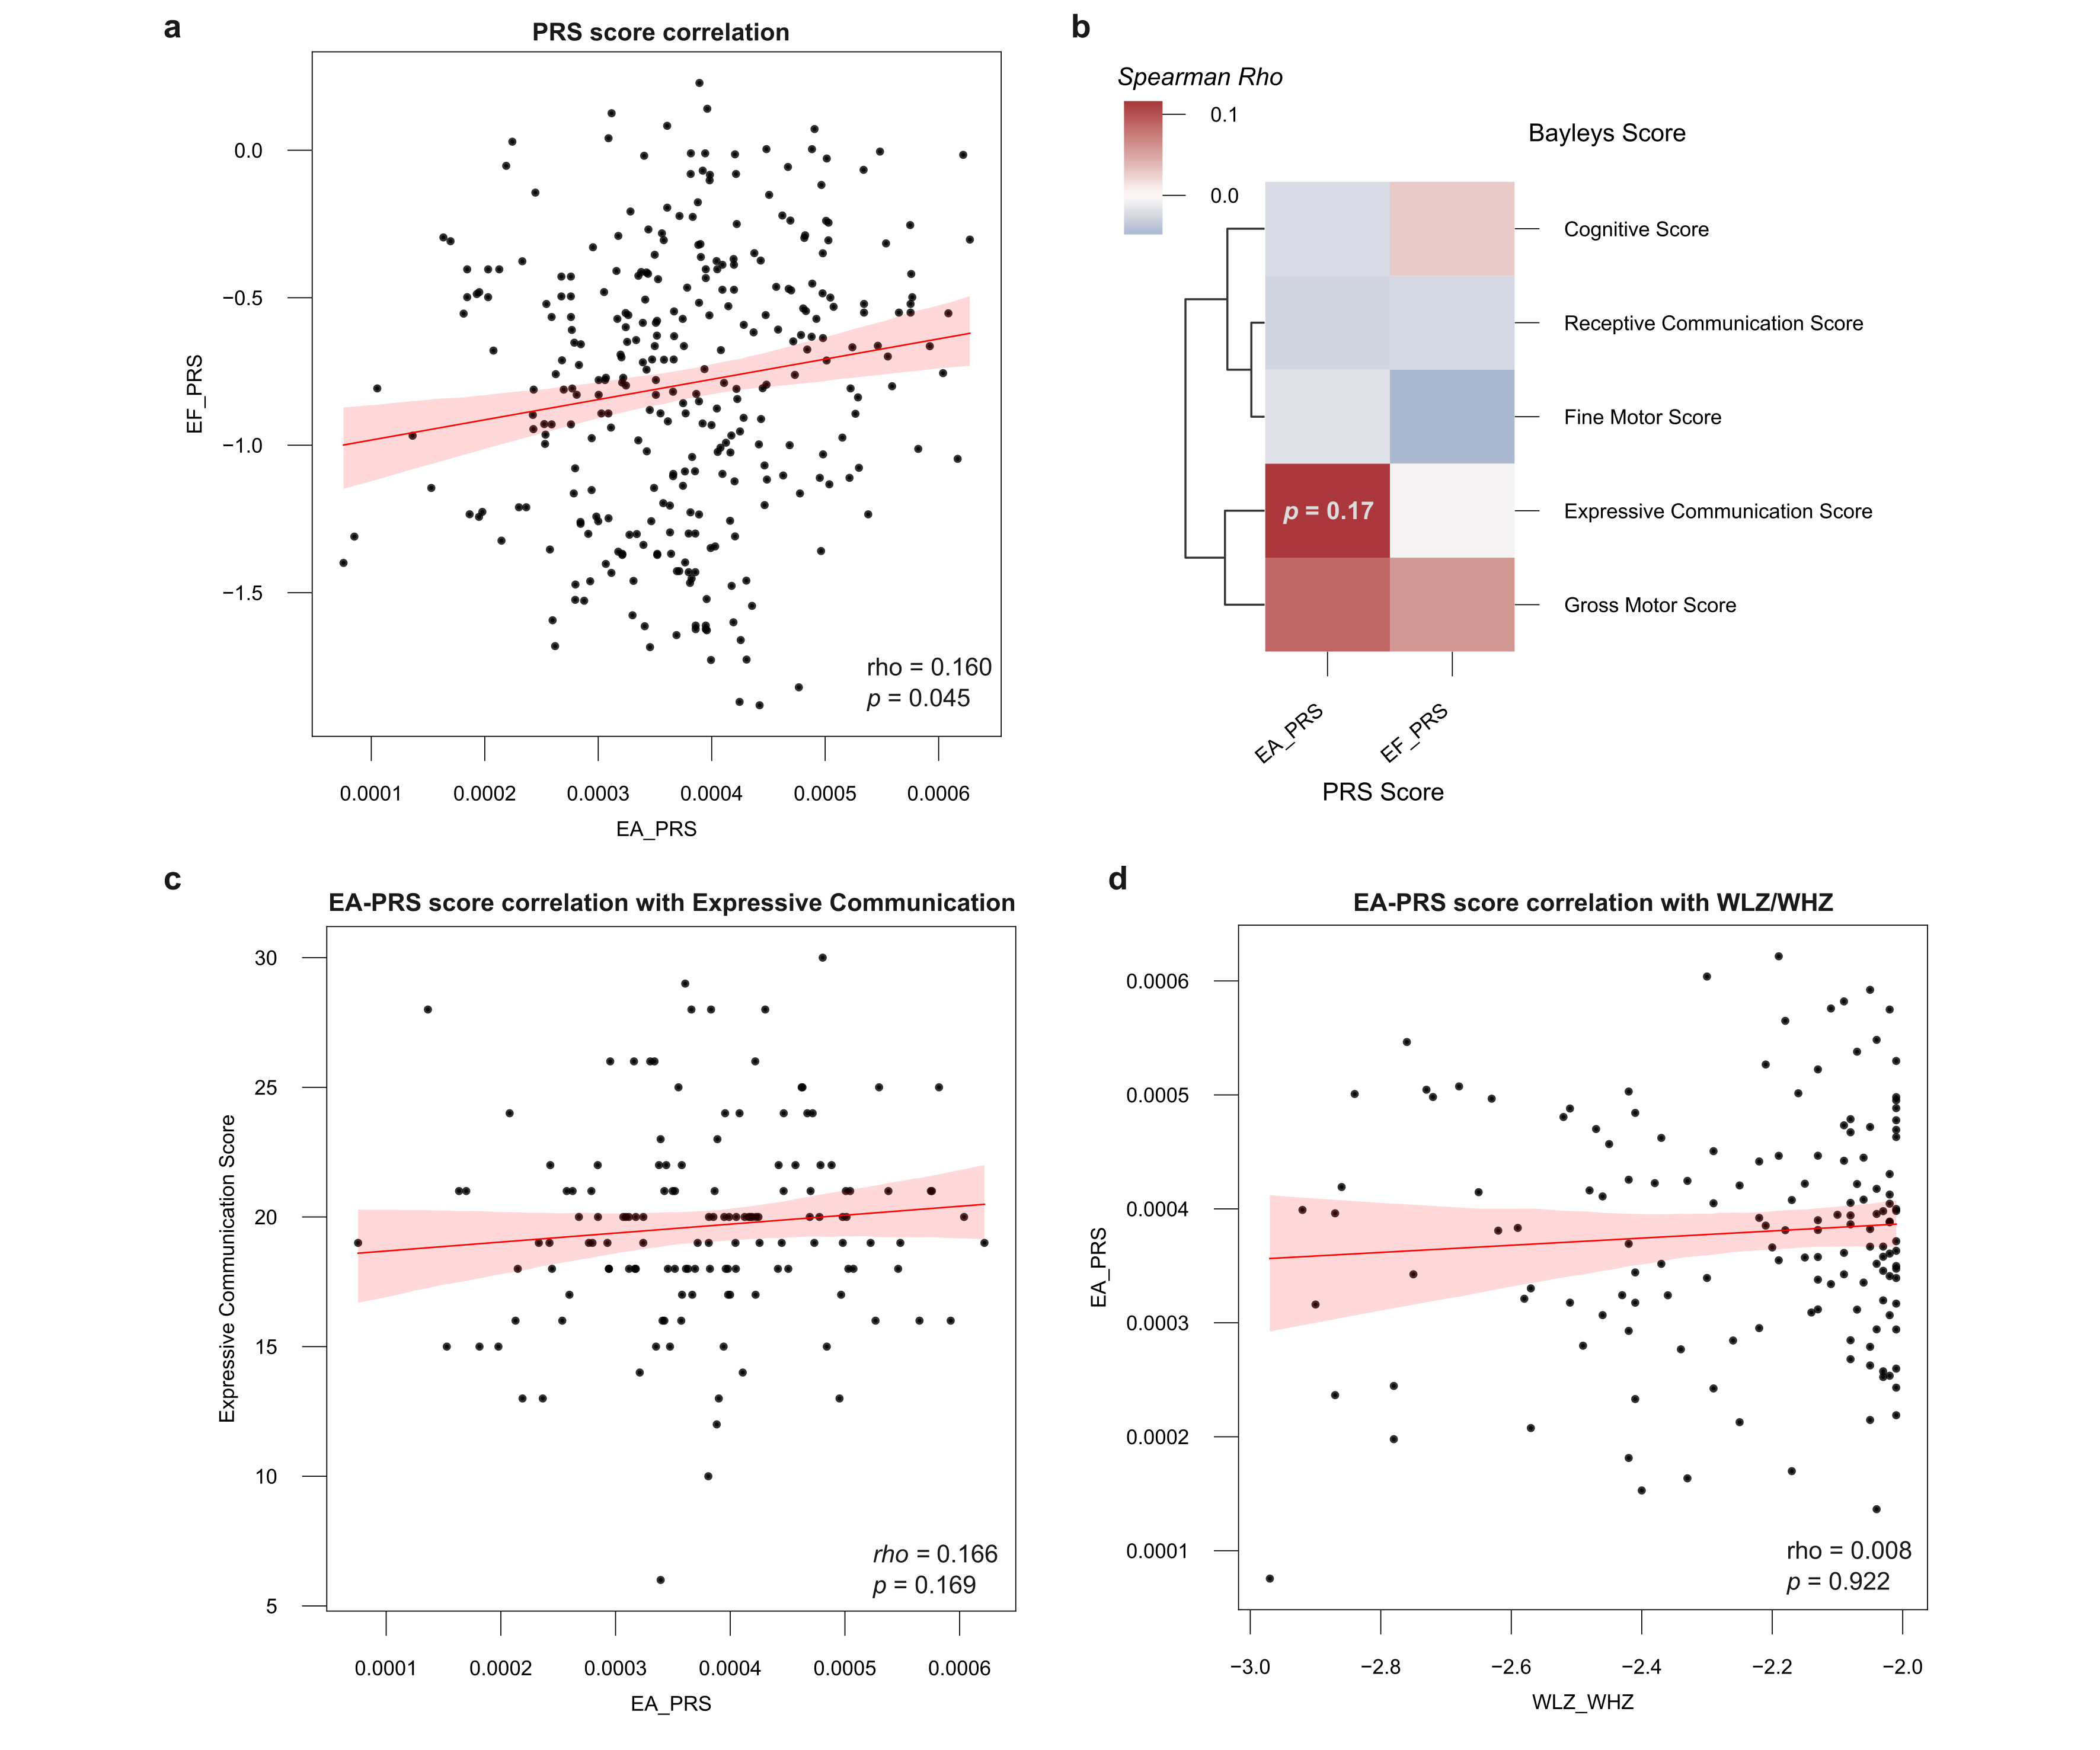
EA-PRS is weakly associated with Expressive communication score
PRS scores for Executive function (EF) and for Educational attainment (EA) are highly correlated.
EA-PRS is correlated with Expressive communication

Slide 19
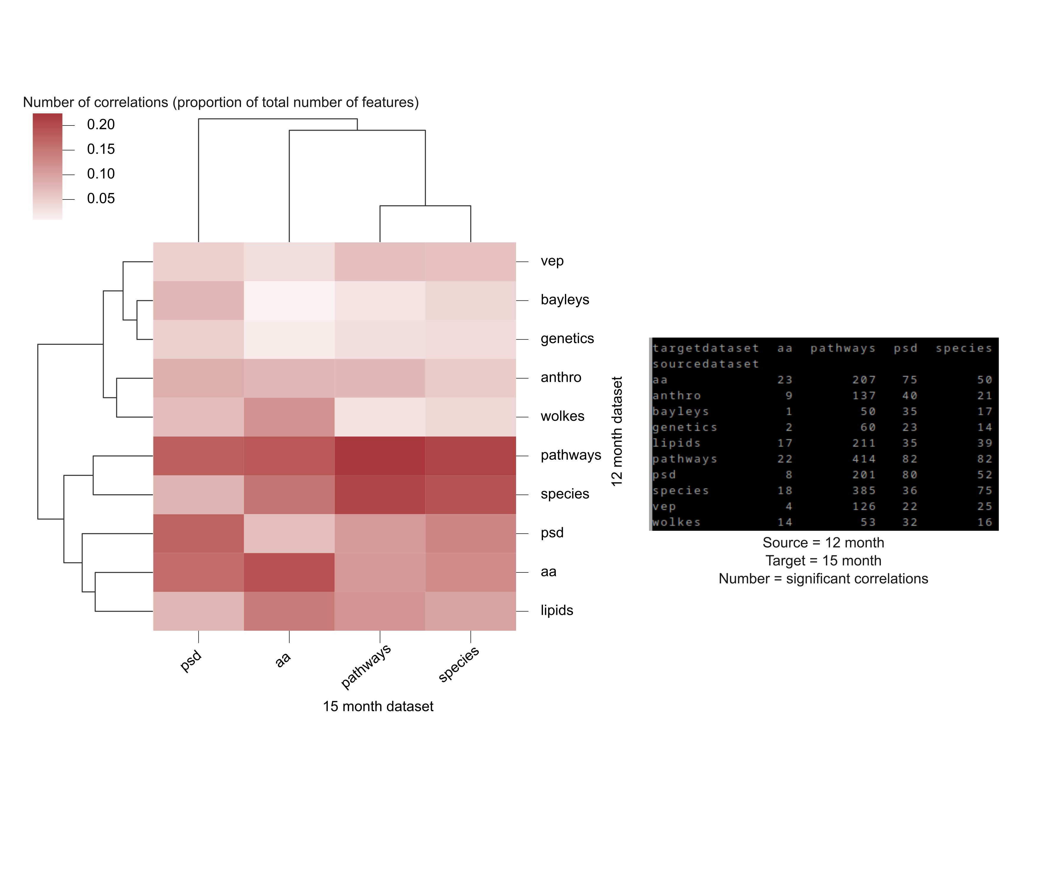
There are significant numbers of correlated variables between different data feature sets over the two time points (12-15 mo).
psd, power spectral density
vep, visual evoked potential
aa, amino acid profile
anthro, anthropometrics
genetics, PRS-EA and PRS-EF

Slide 20
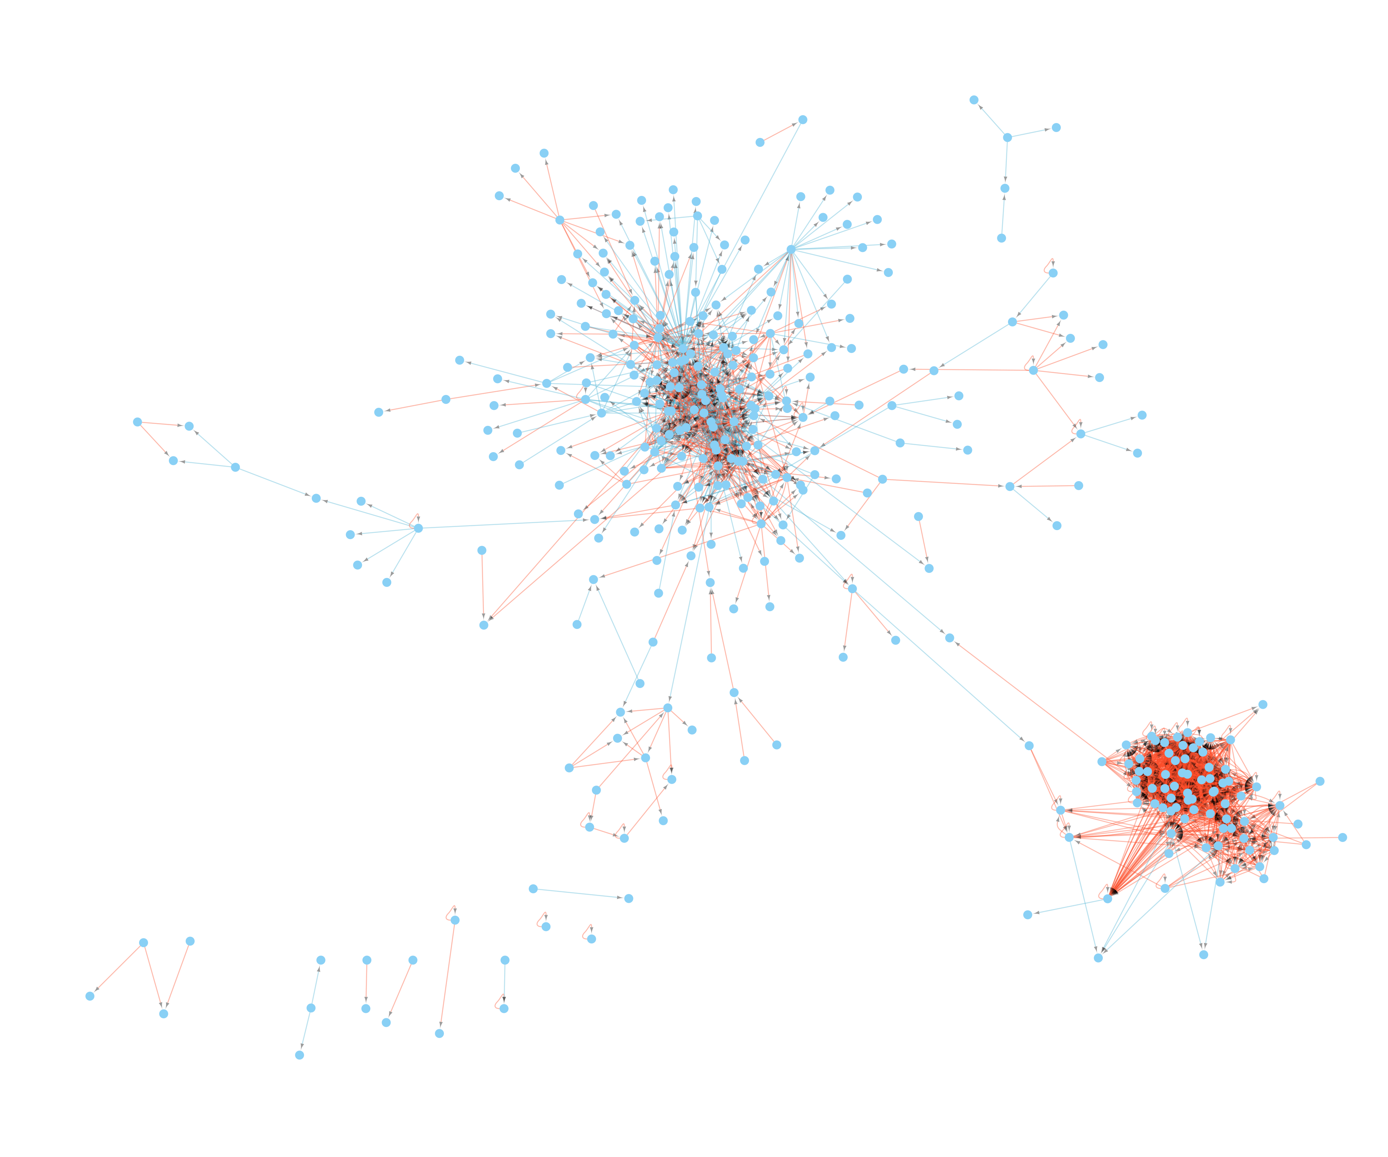
We created a directional network based on the correlation of a variable from 12 months to 15 months (following refeeding)
EEG cluster
MAM cluster
Direction of arrow 12 month variable -> 15 month
positively correlated @15 and 12 months
inversely correlated @15 and 12 months

Slide 21
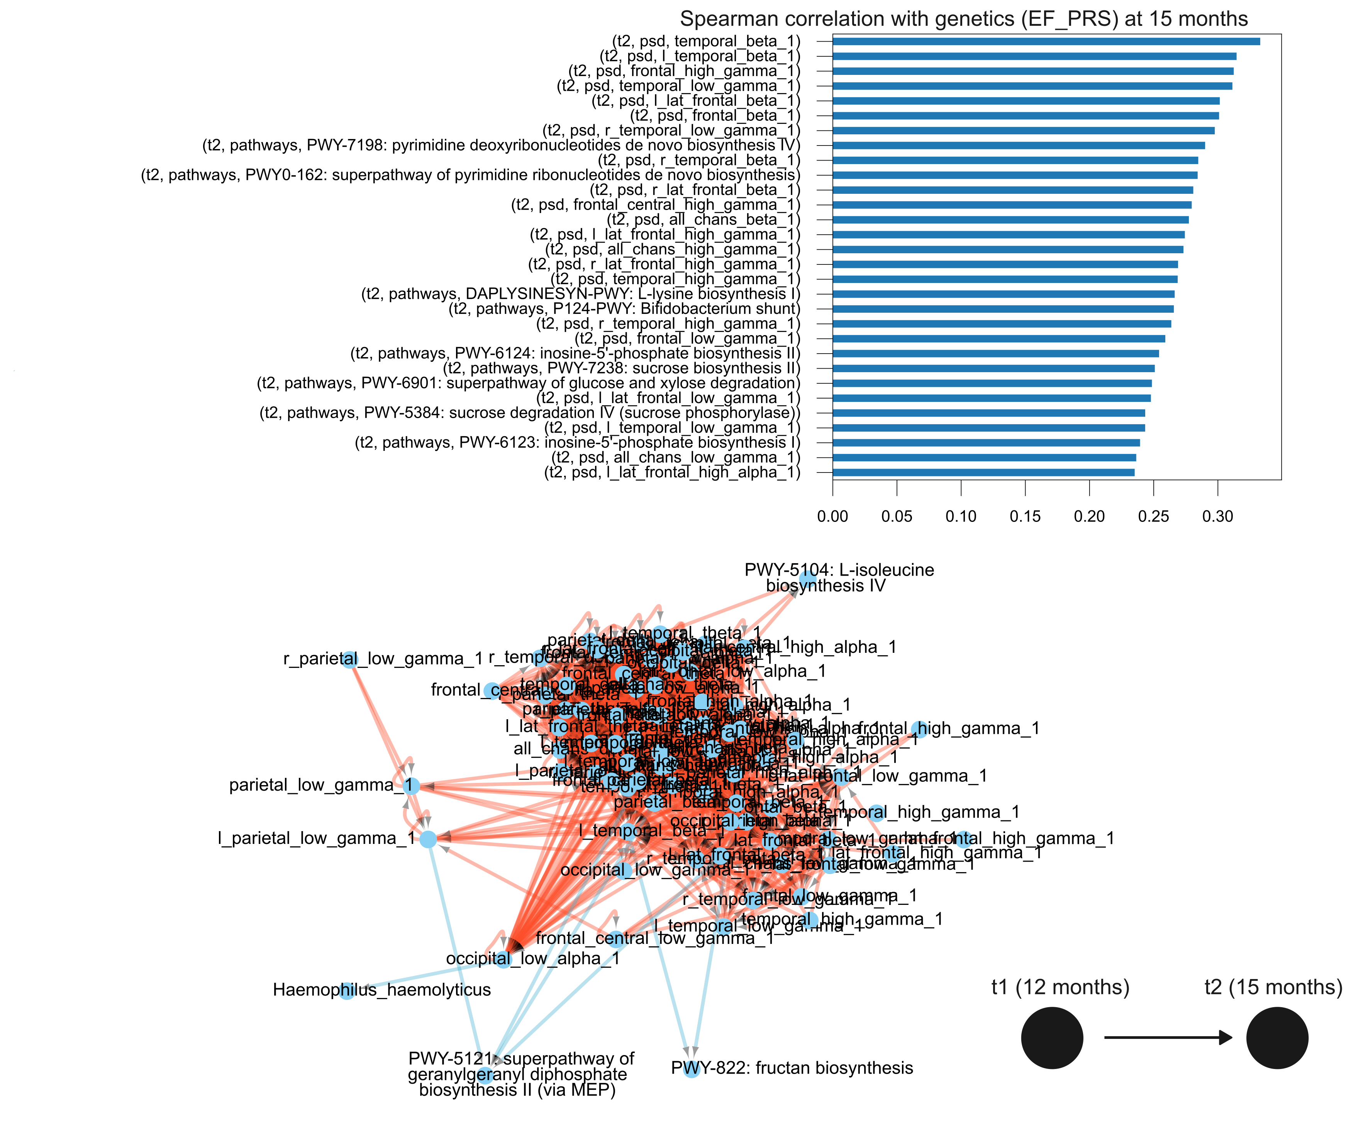
Genetic scores are highly correlated with the EEG PSD
Baseline EEG PSD values are highly correlated with recovery EEG PSD measurements
Direction of arrow 12 month variable -> 15 month
positively correlated @15 and 12 months
inversely correlated @15 and 12 months

Slide 22
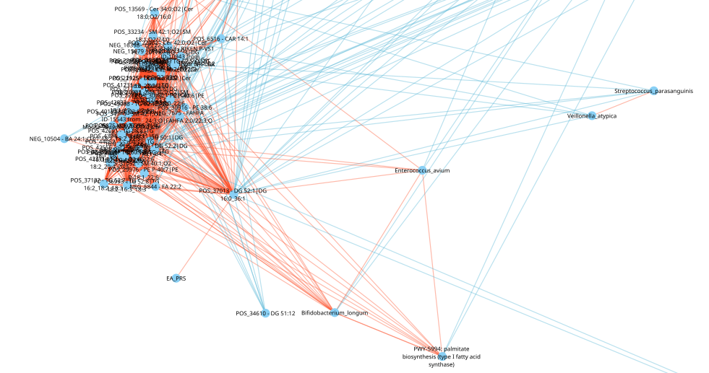
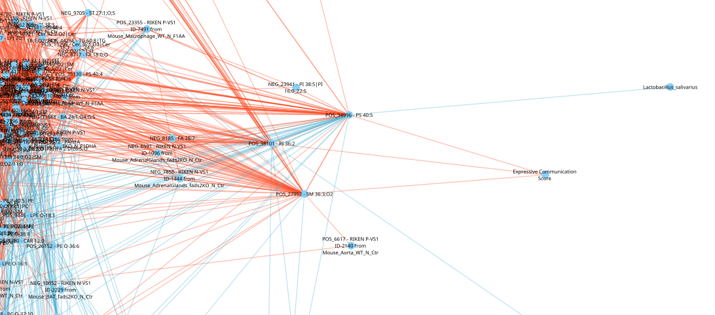
Genetics (EA_PRS) also associated with plasma diglycerides that negatively associate with Streptococcus and Veillonella in the gut
Bayley’s scores are also linked to plasma lipids
Direction of arrow 12 month variable -> 15 month
positively correlated @15 and 12 months
inversely correlated @15 and 12 months

Slide 23
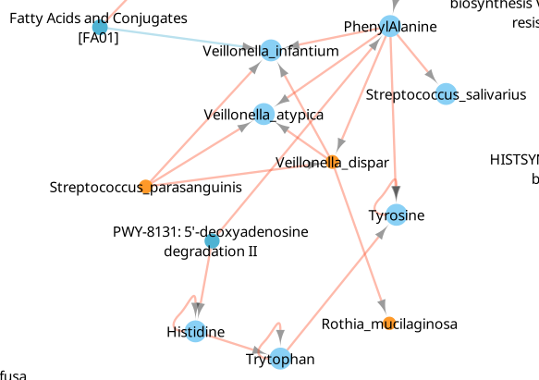
One oral bacterial grouping is enriched in MALNUTRITION
Veillonella and Streptococcus species are enriched in malnutrition and predict one another across time.
Baseline phenylalanine is enriched in malnutrition and is associated with the abundance of S. salivarius, Veilllonella spp. and tyrosine
Baseline Fatty Acids interrupt this system
Direction of arrow 12 month variable -> 15 month
positively correlated @15 and 12 months
inversely correlated @15 and 12 months

Slide 24
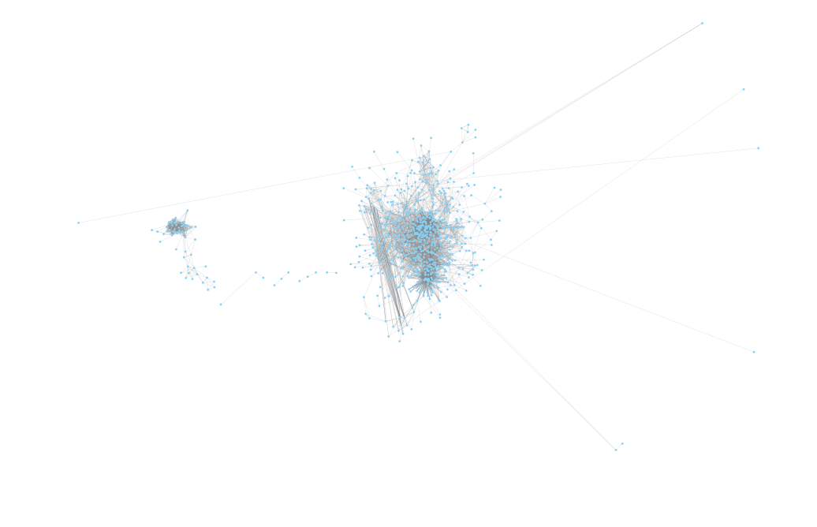
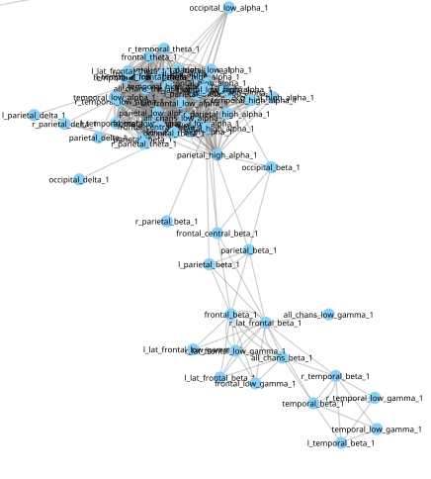
We updated the directional networks to include all data sets

Slide 25
The EEG network is high correlated but not connected to the rest of the data

Slide 26
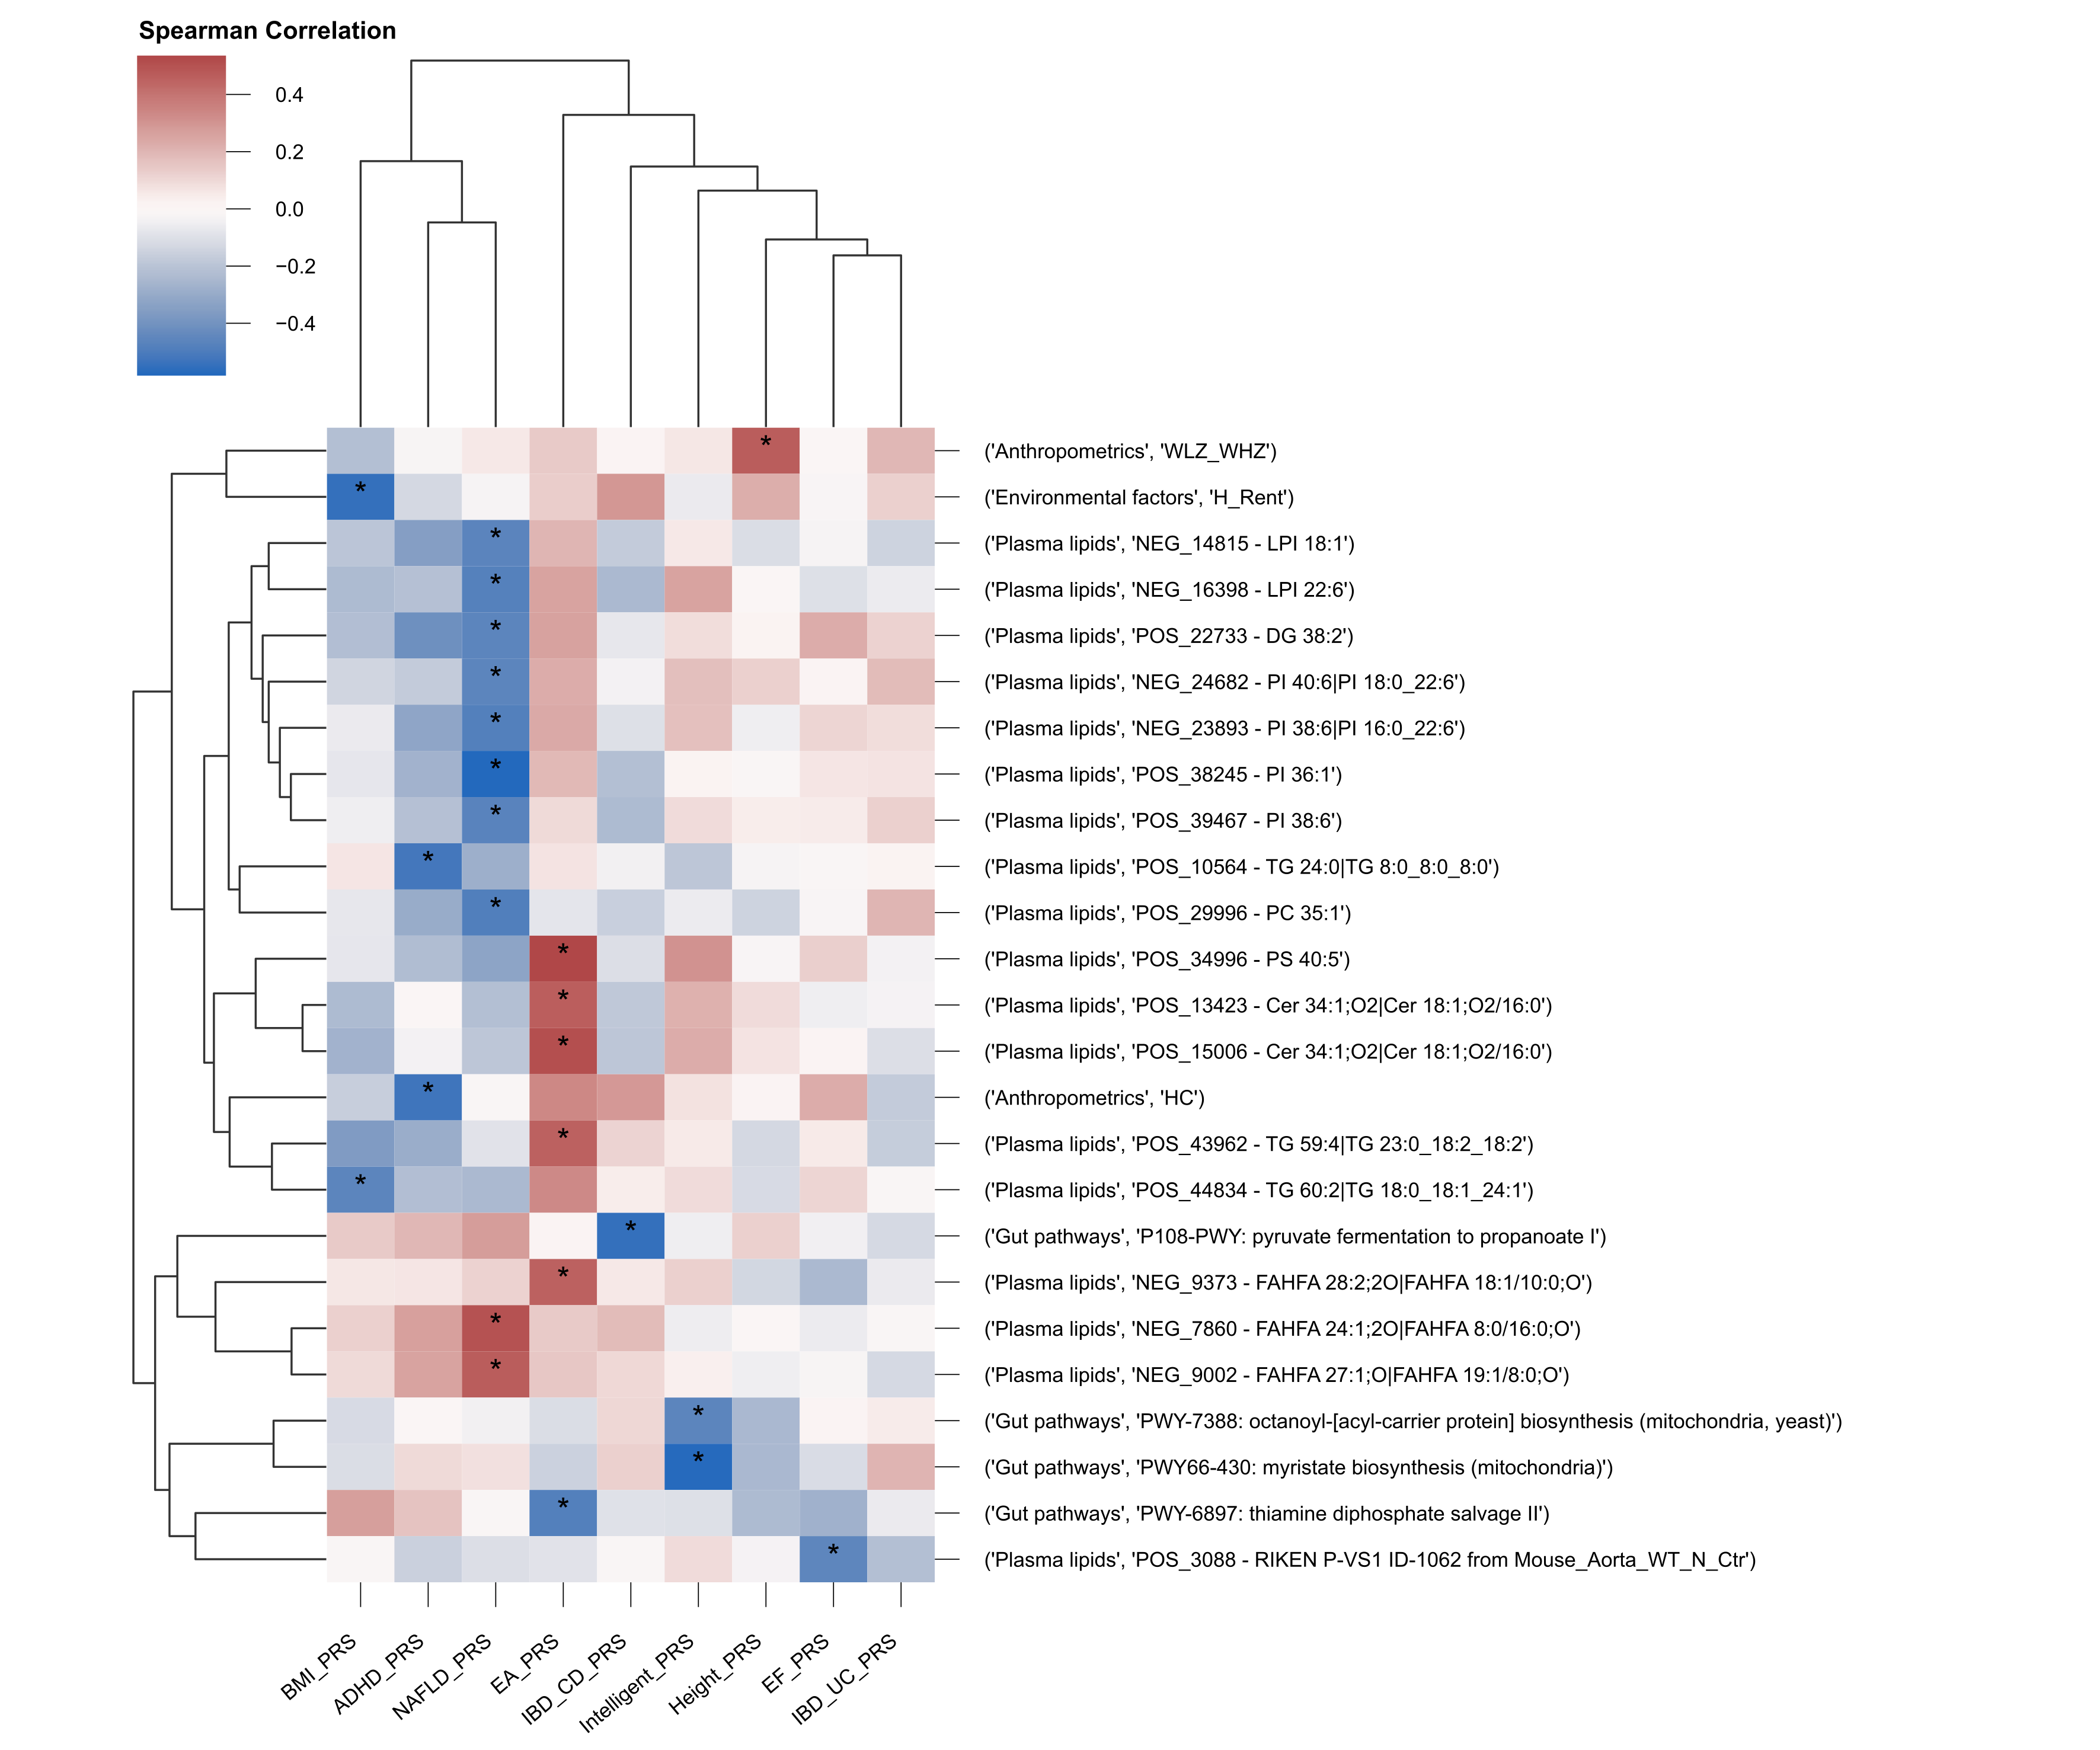
Genetics are highly correlated to

Slide 27
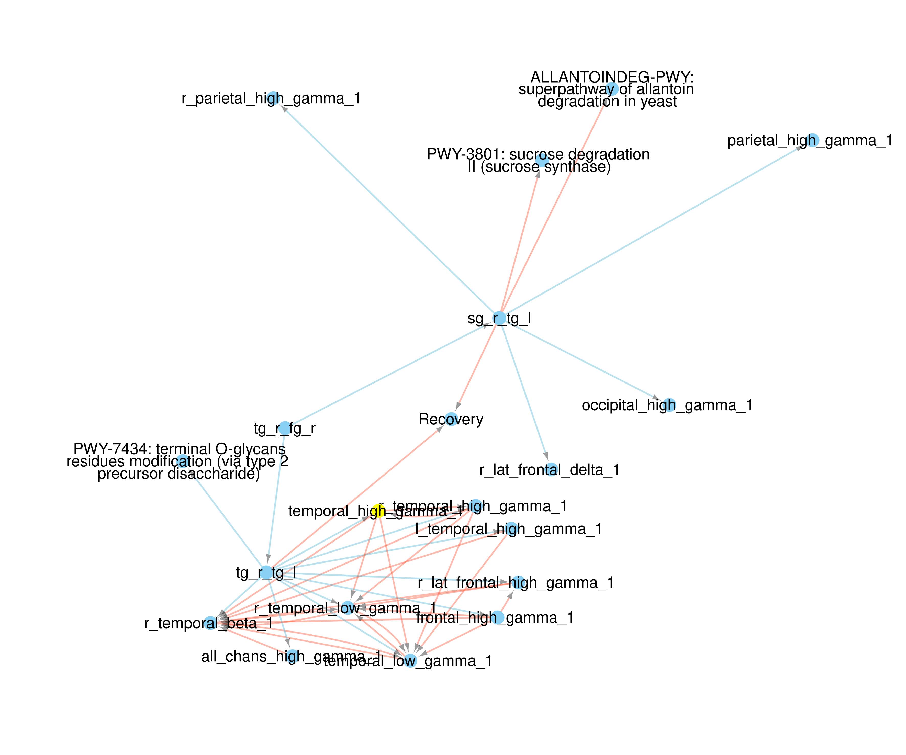
The Recovery network is

Slide 28
Baseline Bayley’s score is
No correlations

Slide 29
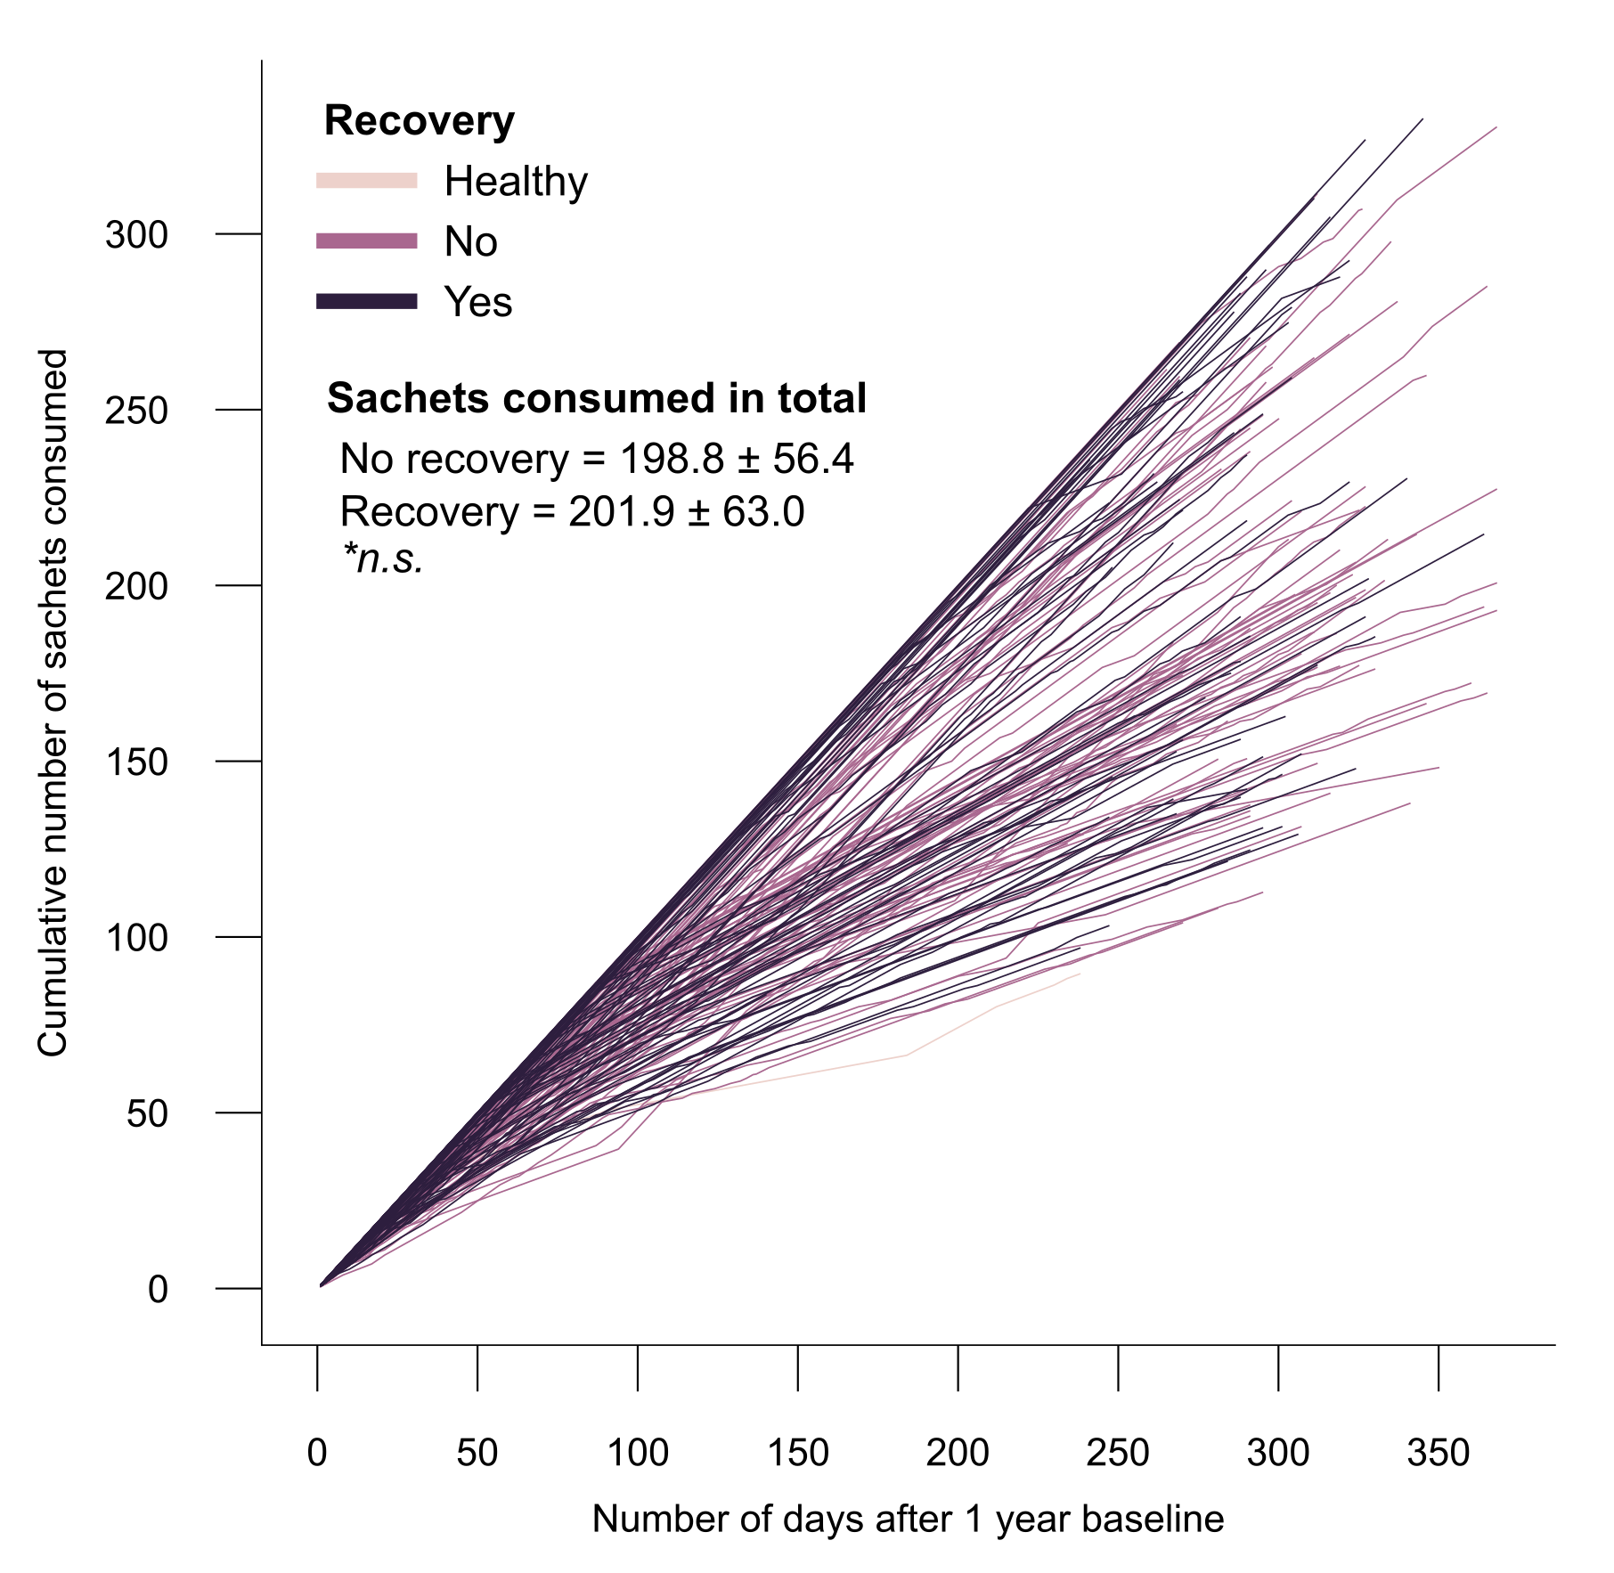
Energy intake

